Slide 1

# WEB 101 : INTRO & HTML5
JIS UNIVERSITY
🕸 🕸 🕷

Slide 2
TABLE OF CONTENTS
01
02
03
04
05
06
INTRODUCTION
FRONTEND vs BACKEND
DIFFERENCE
BACKEND TOOLS
FRONTEND
HTML 5

Slide 3
01-Introduction to Web Development:
“ Web development is the process of creating and maintaining websites and web applications.”
Ex : Social networking platform like Facebook and hotel booking sites like Airbnb.
Websites provide individuals, businesses, organizations, and governments with a global platform to reach a vast audience making information accessible worldwide.
There are two broad division of Web Development - Front-end Development (also called Client-side Development) Back-end Development (also called Server-side Development).

Slide 4
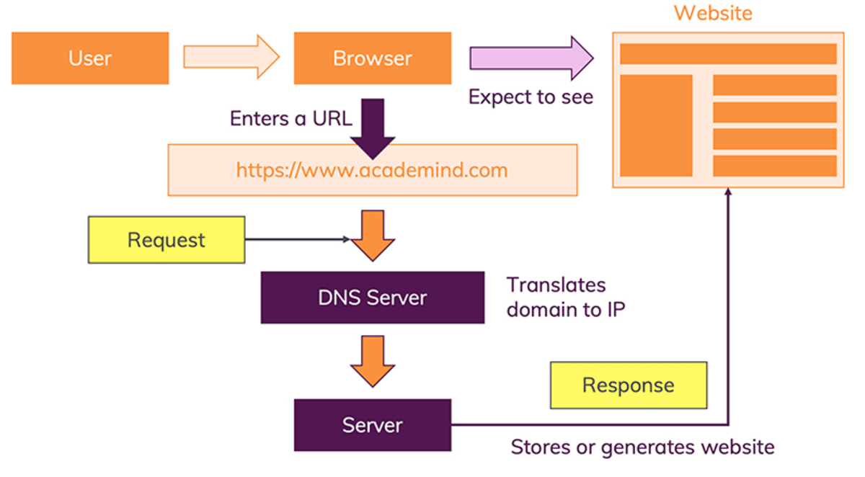
HOW IT WORKS ?

Slide 5
02
Frontend Vs Backend

Slide 6

The Difference
Frontend
Backend
Front end development refers to producing a web application so that a user can see and interact with them directly. It is also known as Client side development. It focuses on the visual elements of a website that a user will interact and is built using HTML,CSS & Javascript.
Backend development complements front end development by handling the operations of a web application. Also known as server-side development, it focuses on creating the server, database, and application logic that power the user-facing front end.

Slide 7
Backend Development Tools
Structured Query Language
Node.js
Django
SQL help us to access and manipulate databases. SQL is a database language, it is used for database creation, deletion, fetching rows, and modifying rows, etc. It can retrieve data and executes queries against the database. n the database.
Node.js is an open-source, server-side JavaScript runtime environment that allows developers to run JavaScript on the server. It is built on the Chrome V8 JavaScript engine .It is used in chat applications, online gaming platforms, streaming services and single pages API.
Django is a high-level Python web framework for rapid development, clean design, and reusability .It is used for building complex web applications that require strong security and scalability, such as news sites, e-commerce platforms, and data-driven web applications.

Slide 8
FRONTEND 😀
Frontend Development includes the layout, design, and functionality of web pages. Frontend developers use a combination of programming languages, frameworks, and libraries to create a user-friendly and visually appealing experience.

Slide 9


#SYSTUMM !!
HTML, CSS, and JavaScript – An Overview
HTML
JavaScript
CSS

Slide 10
## The HTML
ORIGIN
DESCRIPTION
The HTML (Hypertext Markup Language) was developed by Tim Berners-Lee, a British computer scientist, in 1989 at CERN. HTML was created as a means to share documents containing hypertext, which allows users to access information by clicking on links within the text.
HTML is a markup language used for creating & structuring web documents. It consists of a set of elements and tags that define the structure and content of a web page. HTML is not a programming language but a markup language .
HTML for Web Development
HTML5: The Latest Evolution
HTML is a foundational technology for web development. It serves as the structural framework of a web page and provides the basis for organizing content. Used to create web pages and ensure proper accessibility, search engine optimization
HTML5 is the latest version of HTML and represents a significant evolution of the language standardized by the W3C (World Wide Web Consortium) in 2014. HTML5 introduces a range of new features and improvements, such as <audio> <video>.

Slide 11
HTML STRUCTURE
HEADER
MAIN
SECTION
This element is used for the introductory purpose we usually contain our logo, nav menu, etc. inside this element.
The main element is used to hold all the meaningful content i.e, all the section, article, aside tags come inside it.
Section is used to group associated content such as different articles, information cards, etc.
ARTICLE
FOOTER
ASIDE
An article is used for a piece of content on our page that is independent of other content on our web page. for example, a blog post or a news story, etc.
Footer is used for containing content like copyright information, site links, newsletter forms, etc.
Aside is the element used to contain the sidebars on our page.

Slide 12
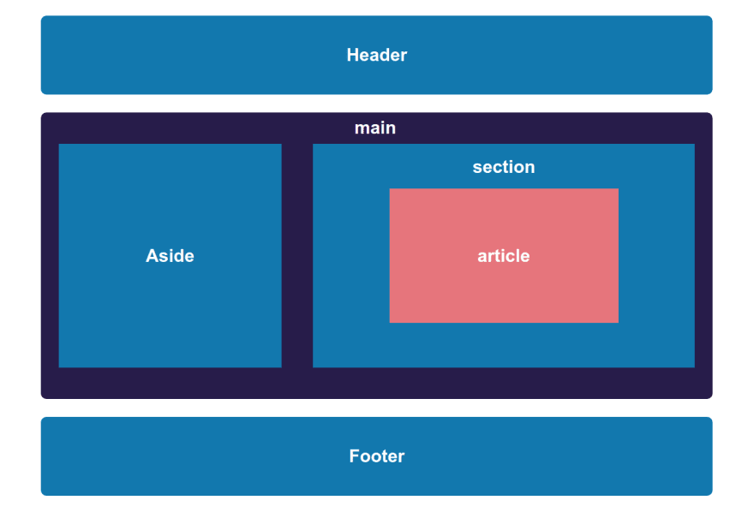
HTML STRUCTURE

Slide 13
HTML SEMANTICS :
DESCRIPTION
WHY USE ?
HTML semantics refers to the meaning and structure of the elements and tags used in HTML to represent content on a web page and to make easy for both humans and machines (e.g., search engines, screen readers) to understand the document.
Search engines like Google use semantics to understand the content of web pages and they rank your web pages. Users can quickly grasp the content's structure and purpose, they can navigate the site more efficiently and find the information they need.
BENEFITS
WHY NOT USE <div> INSTEAD
Clear indication of the role played by our content
Better readability of code
Offer SEO benefits
Better consistency with the new HTML5 specifications
The answer is simple the sole purpose of a <div> is for grouping and styling our content but not to provide semantic meaning to our page. <div> does not provide any meaningful information regarding the type of content to the browser .

Slide 14
HTML :
<html> : is the root element of an HTML document. It encapsulates the entire web page and contains two main sections: <head> and <body>. It defines the document type and character encoding.
<head> : contains meta-information about the document, such as the page title, character encoding, links to external resources (like stylesheets and scripts), and metadata for search engines.
<body>: contains the visible content of the web page. It includes text, images, links, headings, paragraphs, and other elements that are displayed in the browser. This is where you structure and organize the content that users see and interact with.
Attributes :
title: Sets the title of the web page, which appears in the browser tab.
href: Used in <a> tags to specify the URL for hyperlinks.
src: Used in <img>, <script>, and other elements to define the source file or URL.
alt: Provides alternative text for images, which is important for accessibility.
id and class: Used to assign unique identifiers and CSS classes for styling and scripting.
onclick, onmouseover, etc : Event attributes used for JavaScript interaction.

Slide 15
THANKS!

